Slide 1

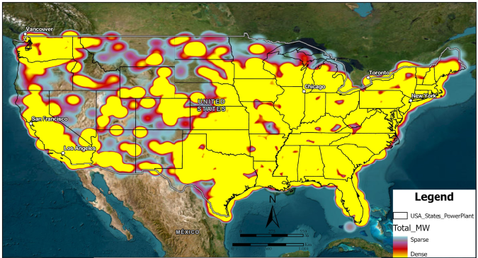
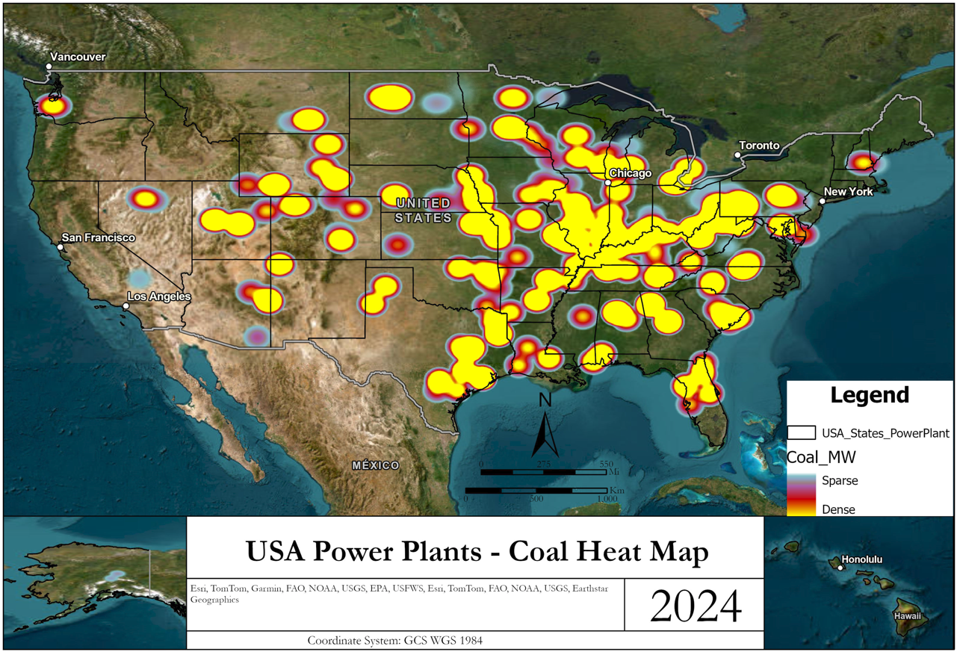
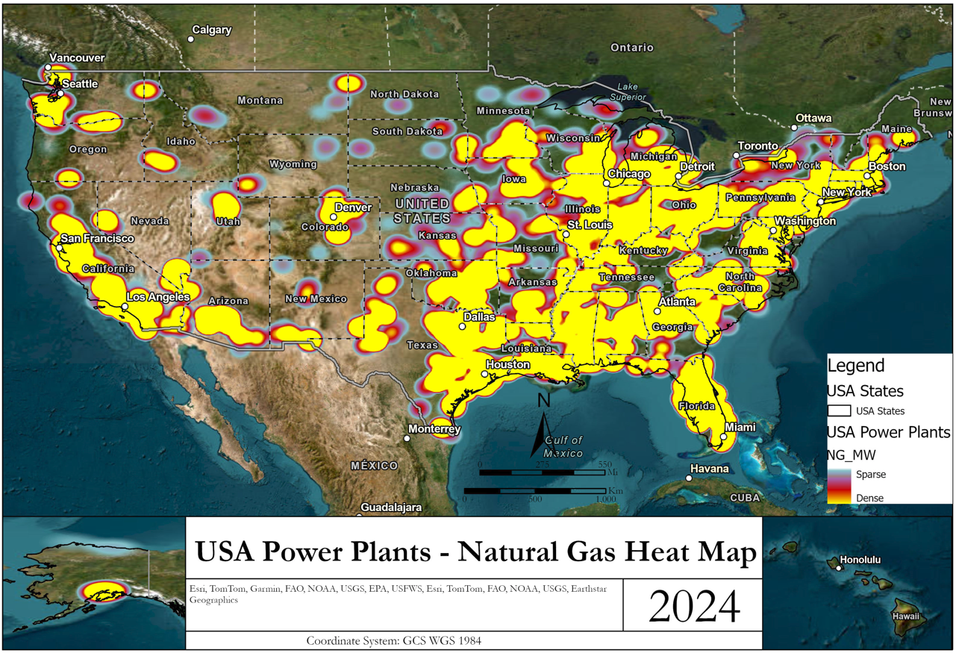
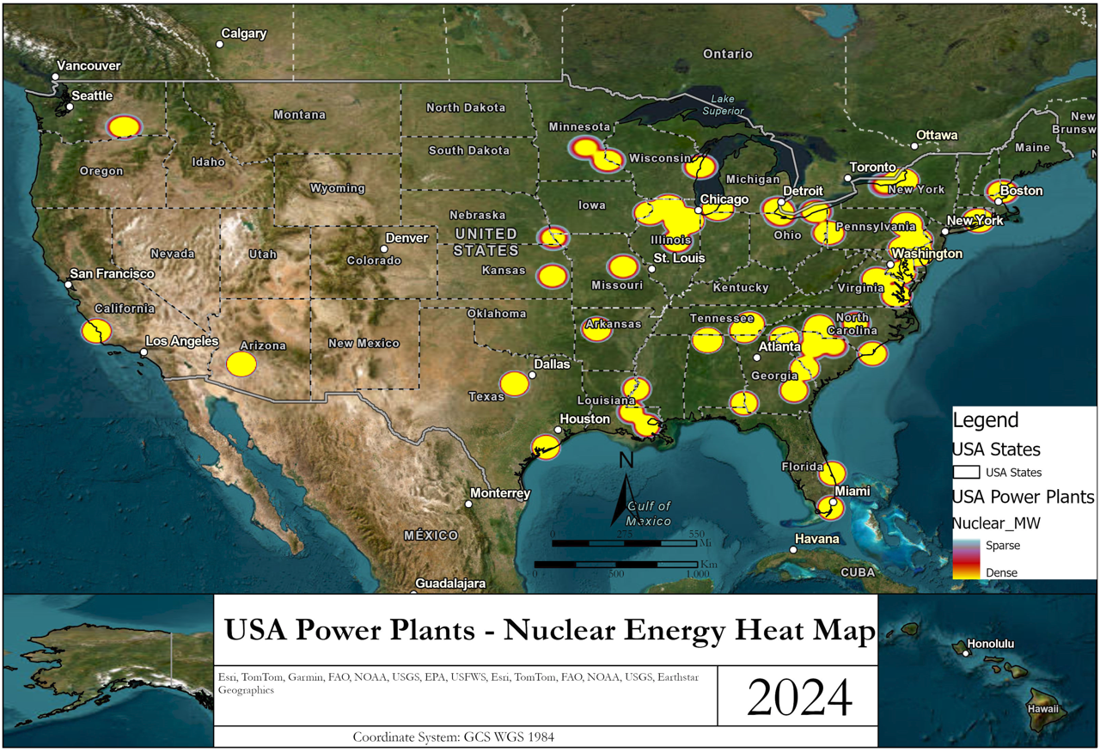
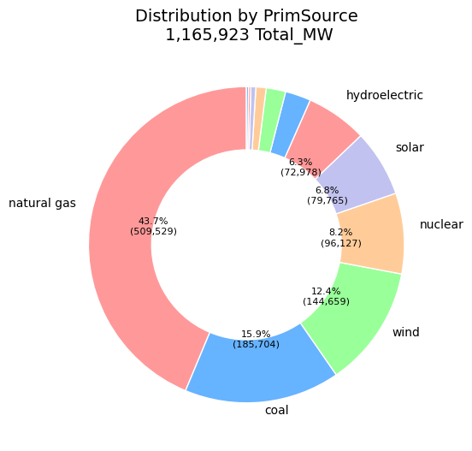
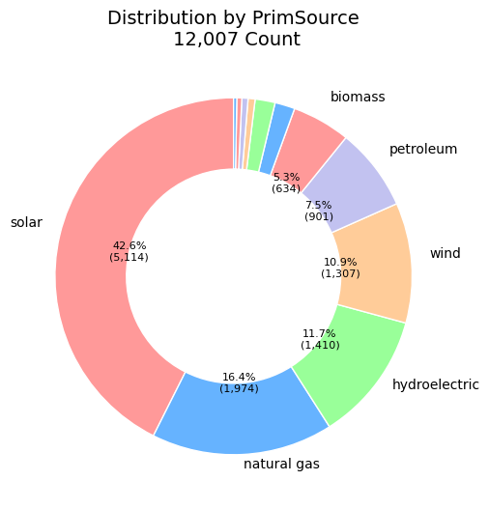
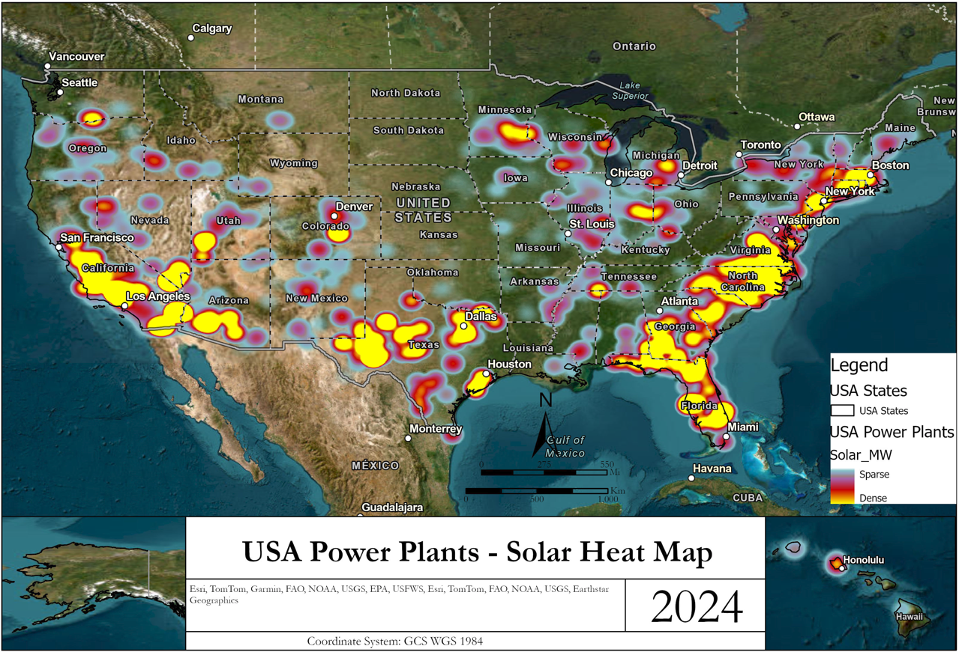
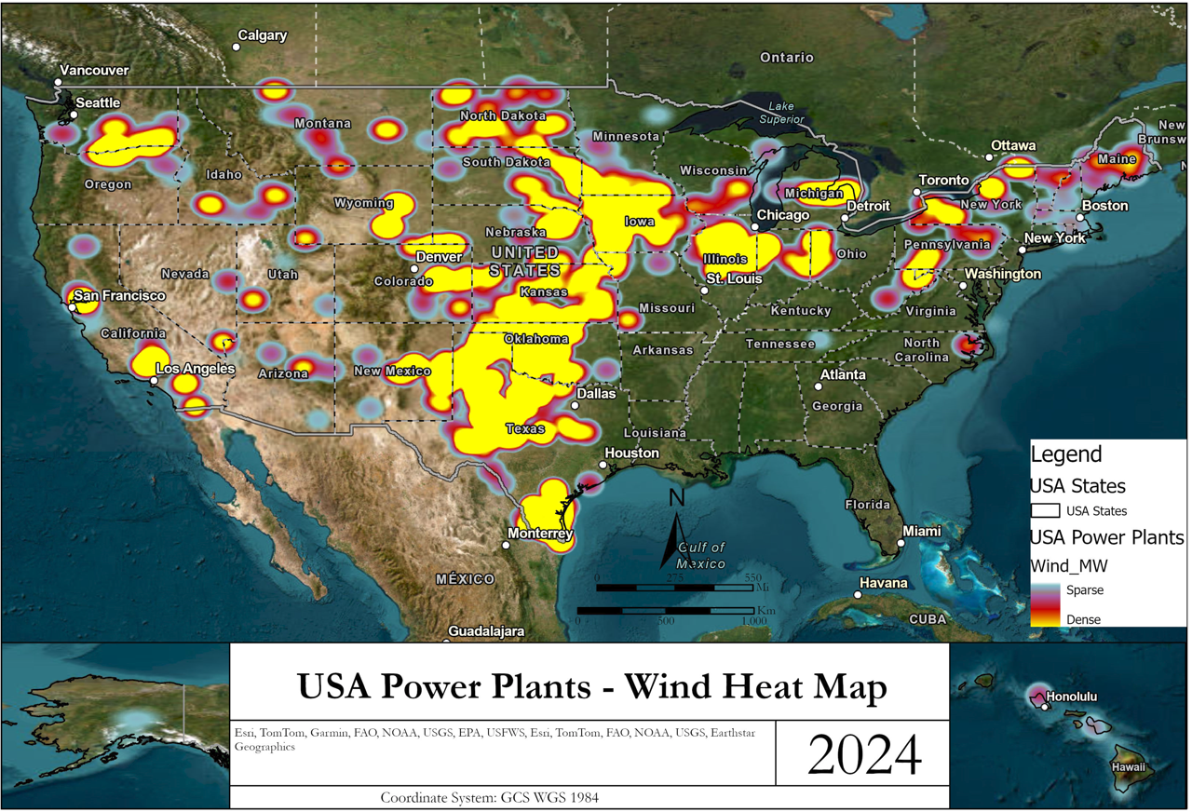
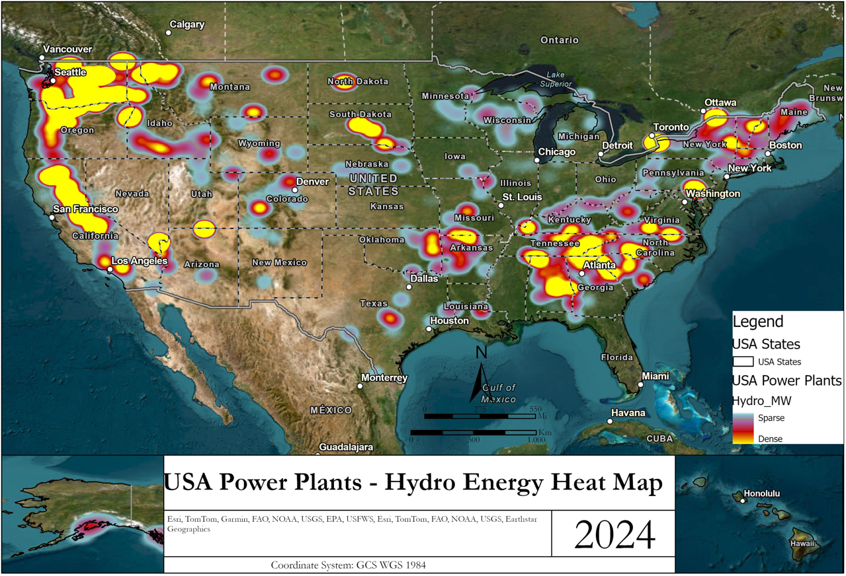
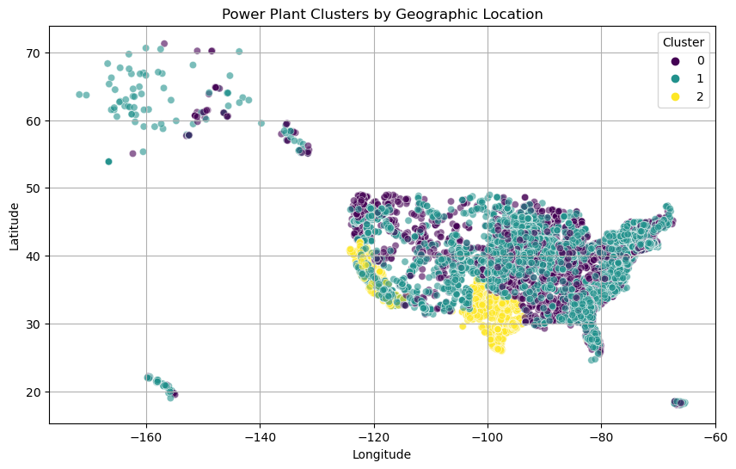
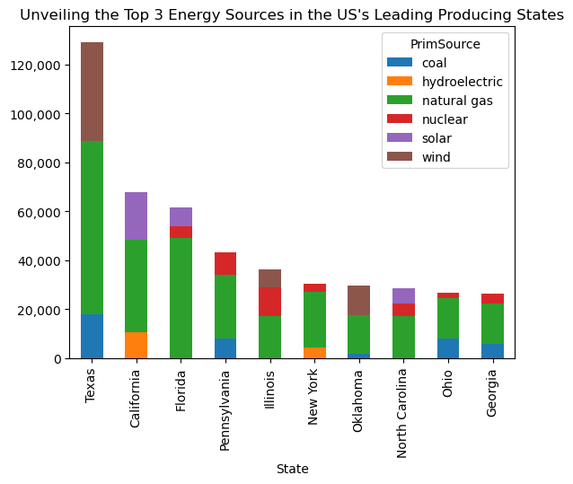
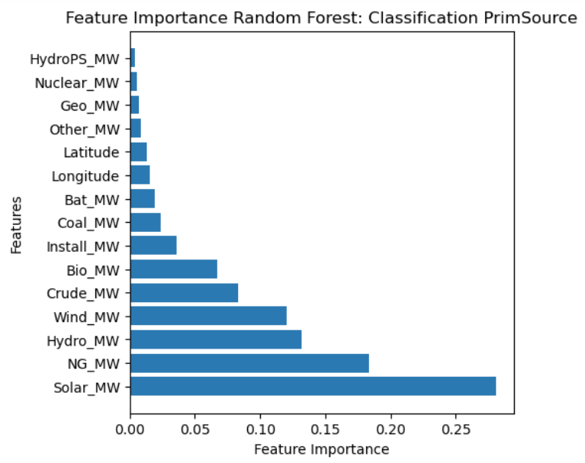
Analysis of Power Plant Energy Generation in the United States using Machine Learning and Geographic Information System (GIS)
Cristian C Noriega M, Blessing Austin-Gabriel, Ernest Chianumba, Rolih Ferdinand, Aparna Varde
Goal
Non-renewable energy
While Natural Gas is leading energy source in the United States, renewable energy sources are poised for future dominance.
The goal is to study the distribution and classification of energy generation based on demographics and power source
Renewable energy
Methods
Unsupervised machine learning using K-Means clustering to understand how similar power generation areas group together
Conclusions
Future work
Supervised machine learning using decision trees and random forest to classify the power sources.
The greatest energy source in the US is natural gas
The greatest number of power plants are solar
How can the energy distribution and findings be modeled using GIS in a user-friendly and interactive manner?
Address CO2 emissions with respect to transition towards cleaner energy, and the demographics
and random forest
What exactly is causing these
-why
Data source
The U.S Energy Information Administration, May 2023

